Slide 1





Slide 2


Content:
Our Team
Our Goal
Stages of Realization
Used Technologies

Slide 3
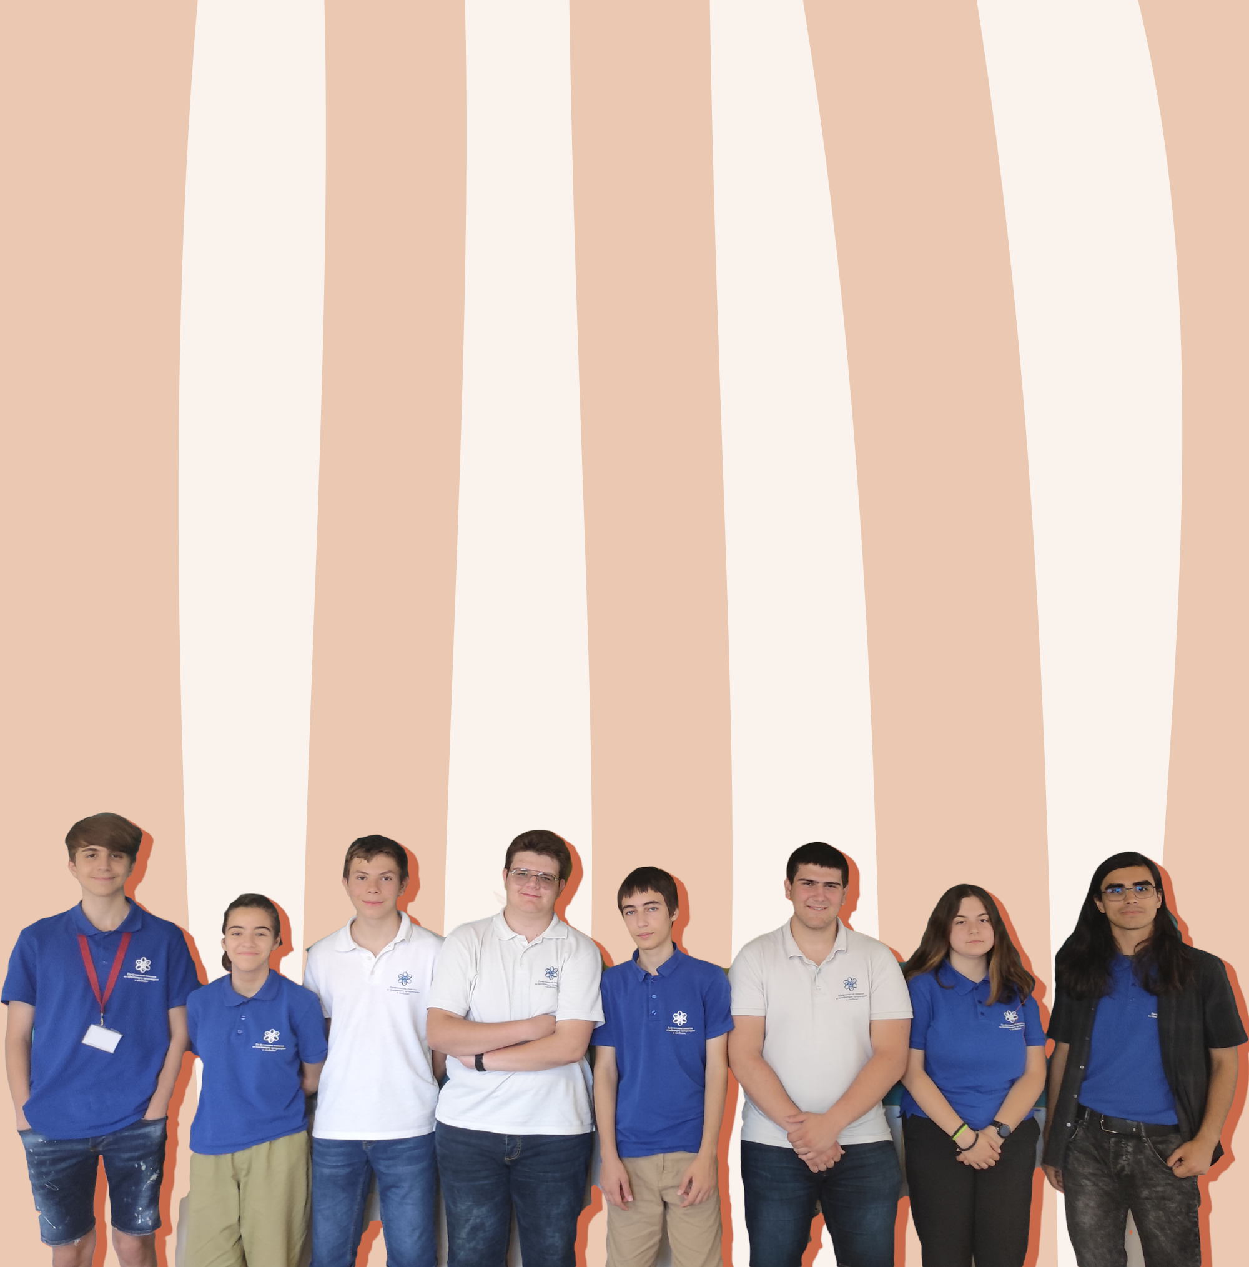


The Team
Петър
Мацалиев
FRONT-END
Йордан
Стоянов
FRONT-END
Димитър
Георгиев
WEBDEV
Галин
Георгиев
BACK-END
Стас
Узунов
SCRUM
Даниел
Георгиев
DESIGNER
Надежда
Иванова
WEBDEV
Теодора
Компанска
DESIGNER

Slide 4


Our Goal
Our main goal is to make a game that immerses the player in a magic and unreal universe.

Slide 5

Stages of
Realization
ORGANIZATION
BRAINSTORM
DEVELOPMENT
PRESENTATION

Slide 6







What We Used

Slide 7

Let’s Continue
With a Demonstration

